Slide 1


Slide 2


 |  |  | FEATURES
 |  |  | Class | Weight | Height | Age | Weekday of Birth
SAMPLES / OBJECTS |  | TRAINING | Basketball | 113 | 203 | 30 | 2
 |  |  | Gymnastics | 51 | 159 | 22 | 4
 |  |  | Gymnastics | 70 | 178 | 29 | 3
 |  |  | Basketball | 100 | 208 | 21 | 3
 |  |  | Basketball | 99 | 198 | 31 | 1
 |  |  | Gymnastics | 55 | 161 | 26 | 1
 |  |  | Basketball | 91 | 191 | 26 | 5
 |  |  | Basketball | 110 | 208 | 26 | 7
 |  |  | Gymnastics | 68 | 173 | 28 | 4
 |  | TEST | ??? | 61 | 156 | 24 | 4
 |  |  | ??? | 53 | 158 | 27 | 2
 |  |  | ??? | 102 | 196 | 25 | 6

Slide 3

 |  |  | FEATURES
 |  |  | Class | 200SMA | P/E | RSI14 | Weekday
SAMPLES |  | TRAINING | Up tomorrow | 113 | 203 | 30 | 2
 |  |  | Down tomorrow | 51 | 159 | 22 | 4
 |  |  | Down tomorrow | 70 | 178 | 29 | 3
 |  |  | Up tomorrow | 100 | 208 | 21 | 3
 |  |  | Up tomorrow | 99 | 198 | 31 | 1
 |  |  | Down tomorrow | 55 | 161 | 26 | 1
 |  |  | Up tomorrow | 91 | 191 | 26 | 5
 |  |  | Up tomorrow | 110 | 208 | 26 | 7
 |  |  | Down tomorrow | 68 | 173 | 28 | 4
 |  | TEST | ??? | 61 | 156 | 24 | 4
 |  |  | ??? | 53 | 158 | 27 | 2
 |  |  | ??? | 102 | 196 | 25 | 6

Slide 4
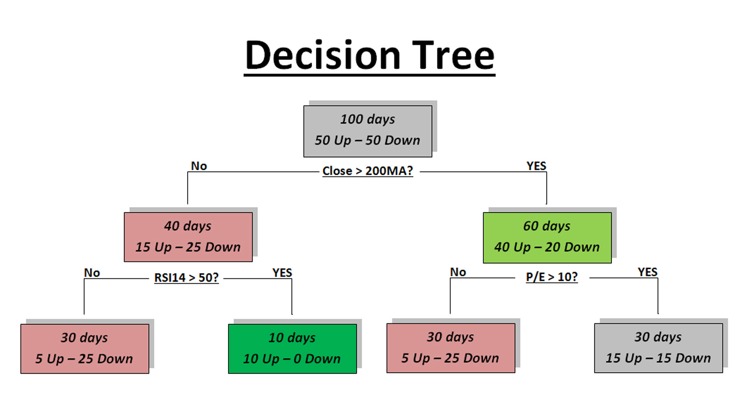

Slide 5
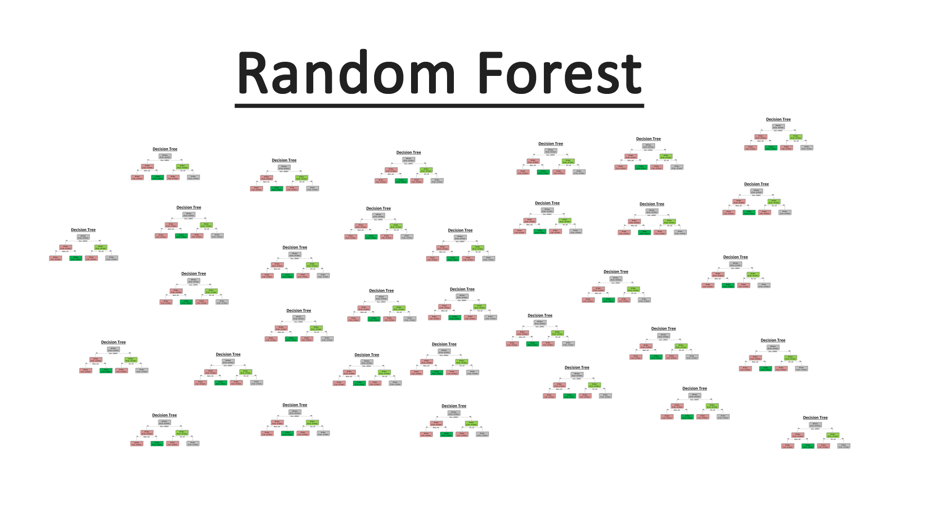

Slide 6




Slide 7
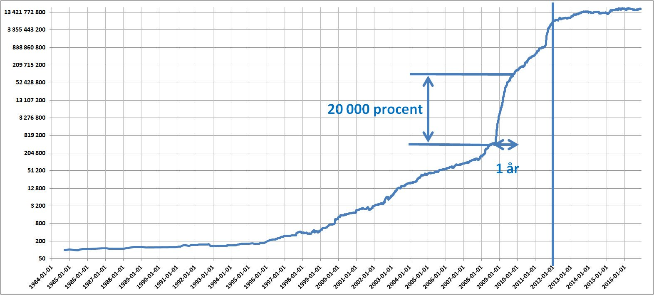

Slide 8
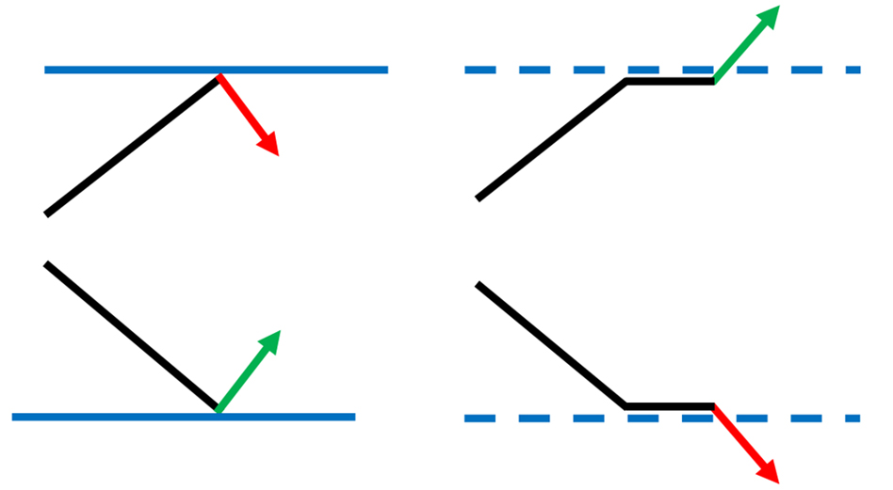

Slide 9
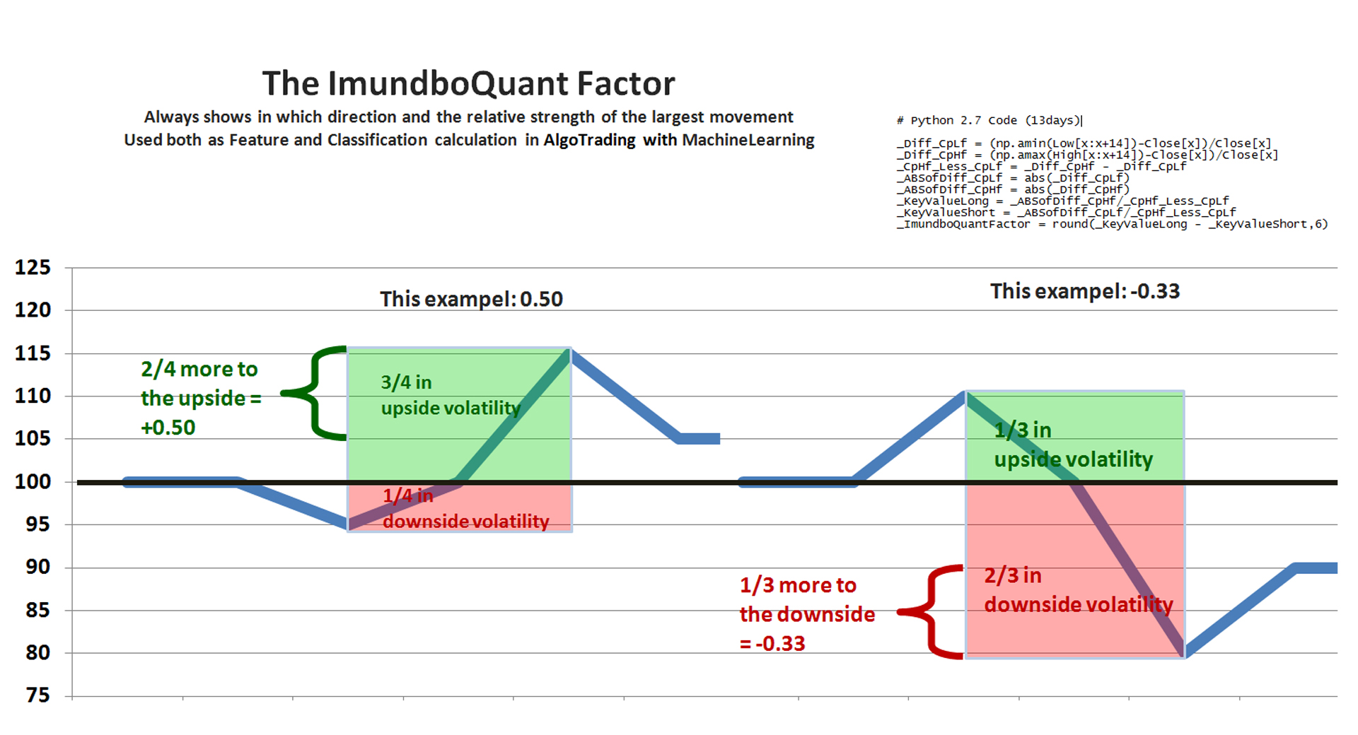

Slide 10
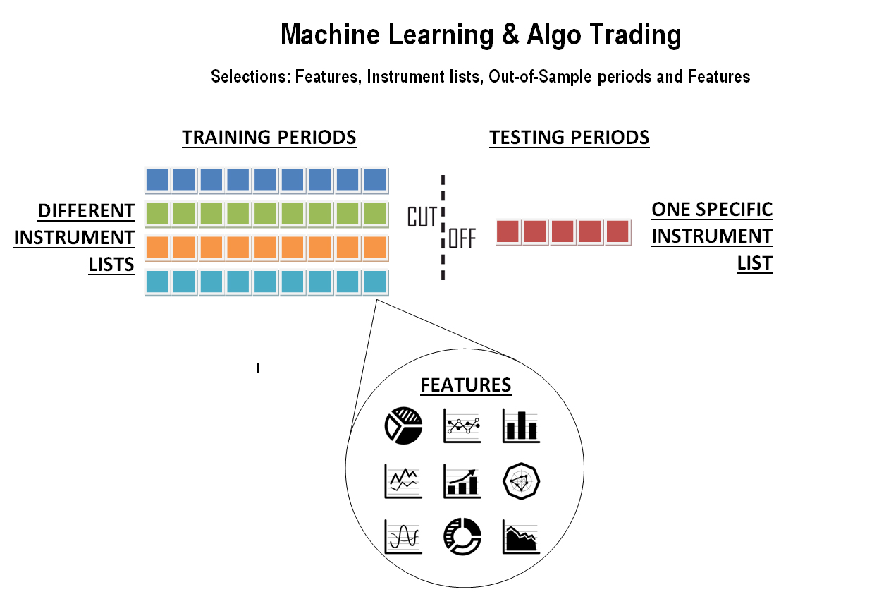

Slide 11
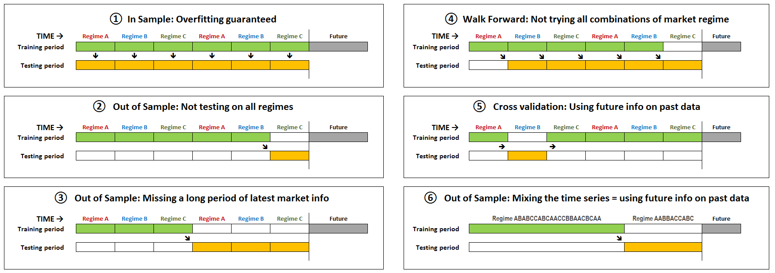

Slide 12
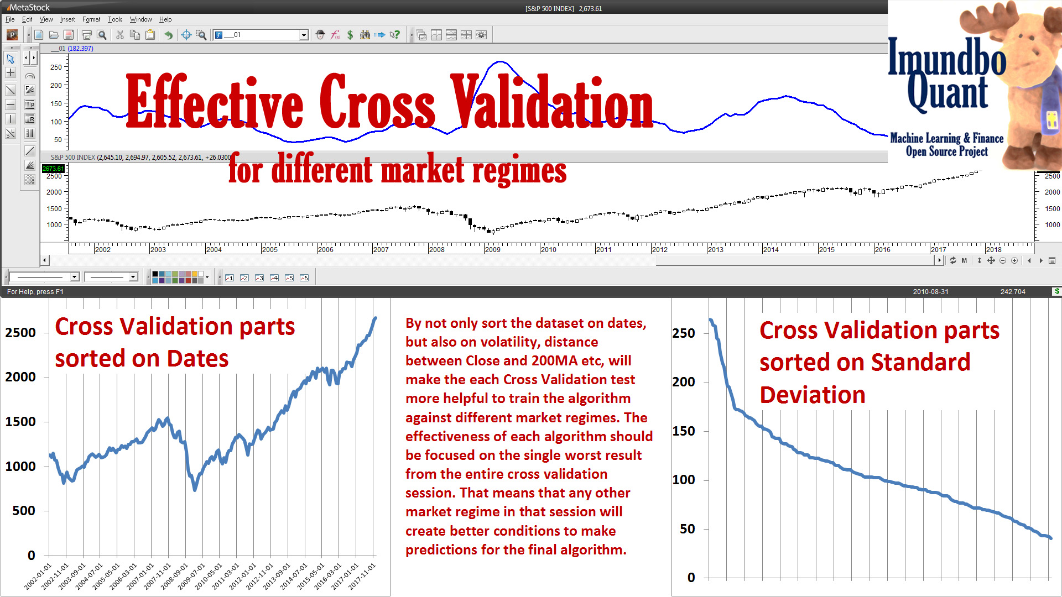

Slide 13
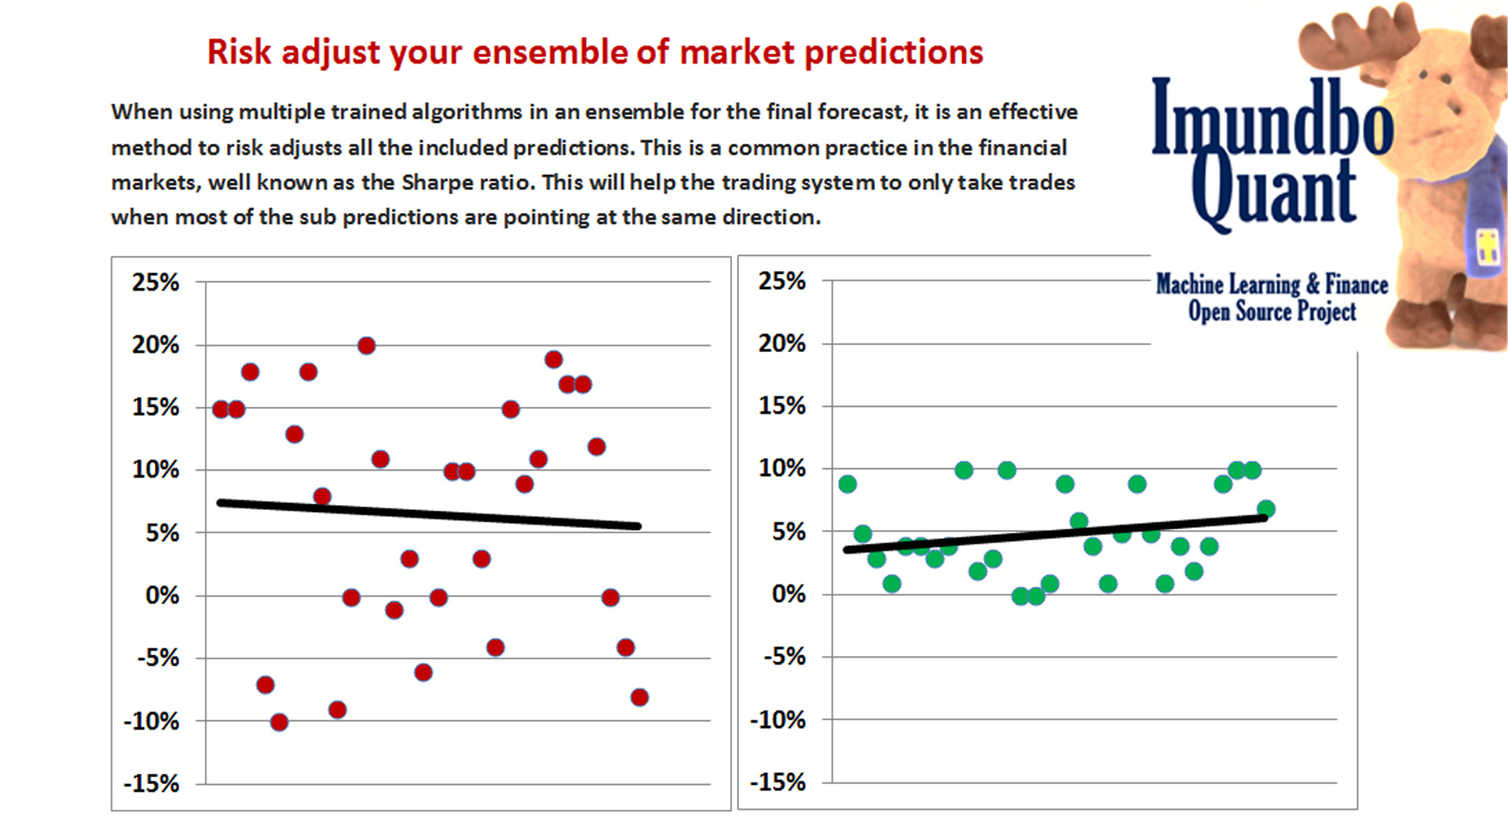

Slide 14
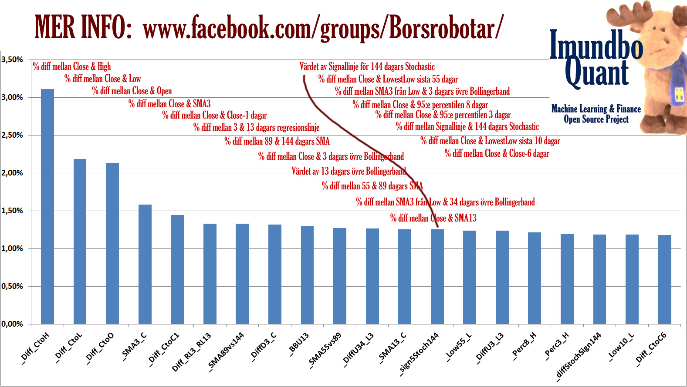

Slide 15


